Slide 1

Applied Analytics Project CUS-690 Group 3
Di-heng Liu, Walker Stipe, Pablo Sanchez,
Shelina Khan-Khutan, Tian Lan

Slide 2

Focus of Project
Distributed Computing Methods
Semantic Relationships
Sentiment Analysis (Polarity)
Data Visualization
Notes:
Pablo
Application of Distributed Computing Methods
Exploration of Semantic Relationships
Sentiment Analysis – polarity
Visualization of outputs

Slide 3
Methodology
Preprocessing
Sentiment Analysis
Word2Vec
Bokeh Plot
Polarity
Time Series
Synonyms
Notes:
Pablo/ Shelina

Slide 4
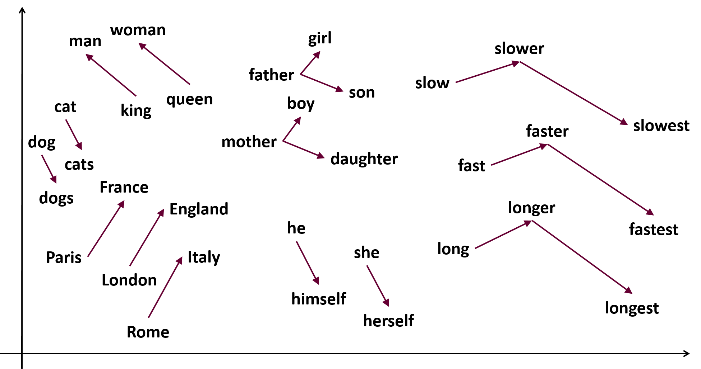
Word2Vec
“You shall know a word by the company it keeps”
- John R. Firth, 1957
Notes:
Pablo

Slide 5
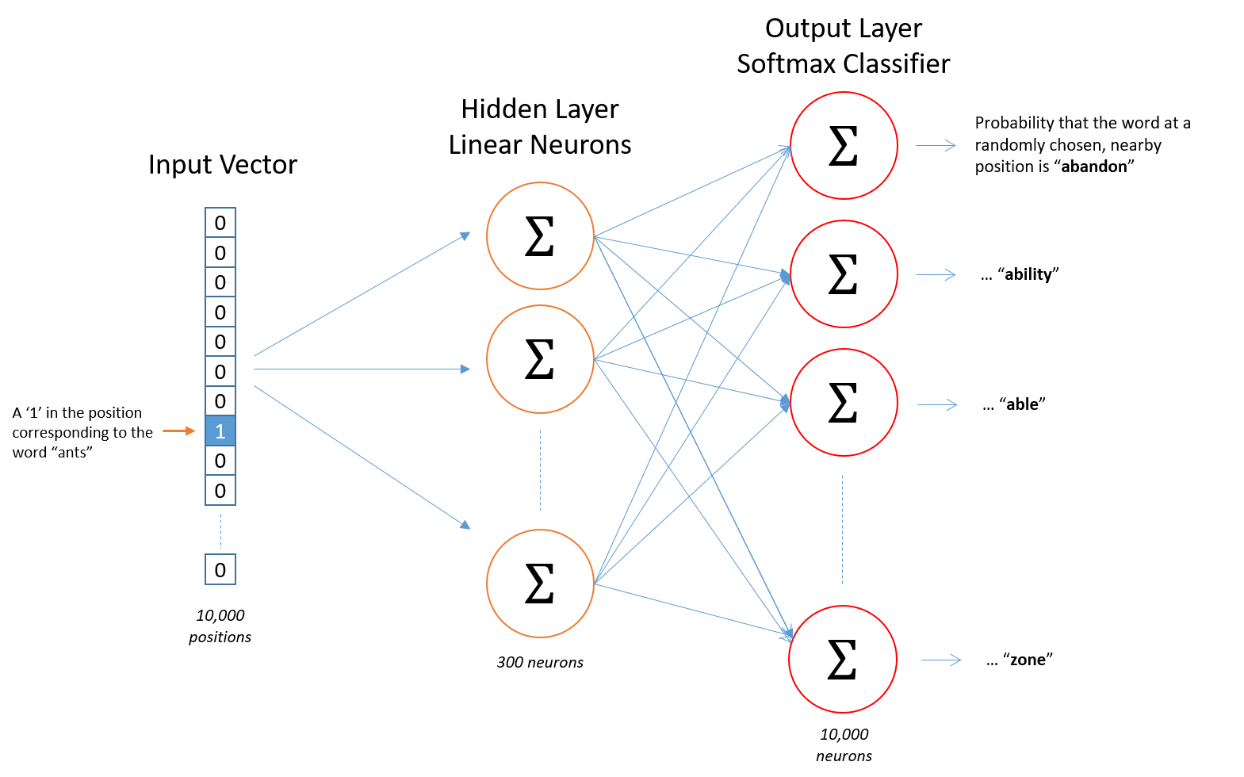
What is Word2Vec?
Notes:
Walker

Slide 6
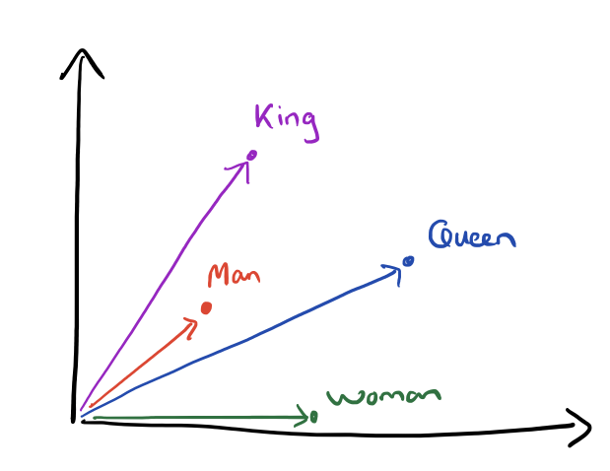
How can one use Word2Vec?
from pyspark.sql.functions import format_number as fmt
m = model.findSynonyms("clinton", 10).select("word", fmt("similarity", 6).alias("similarity"))
display(m)
FindSynonyms calculate the top n closest terms from a given point, using Euclidean distance.
One can begin with known important words to locate other interesting terms.
Dimensionality reduction to create a 2-dimensional visualization, where distance denotes similarity
Notes:
Walker / Pablo

Slide 7
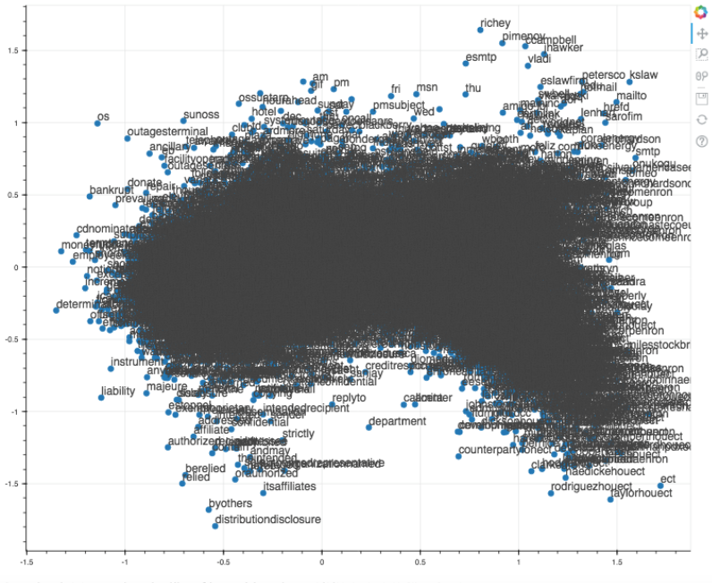
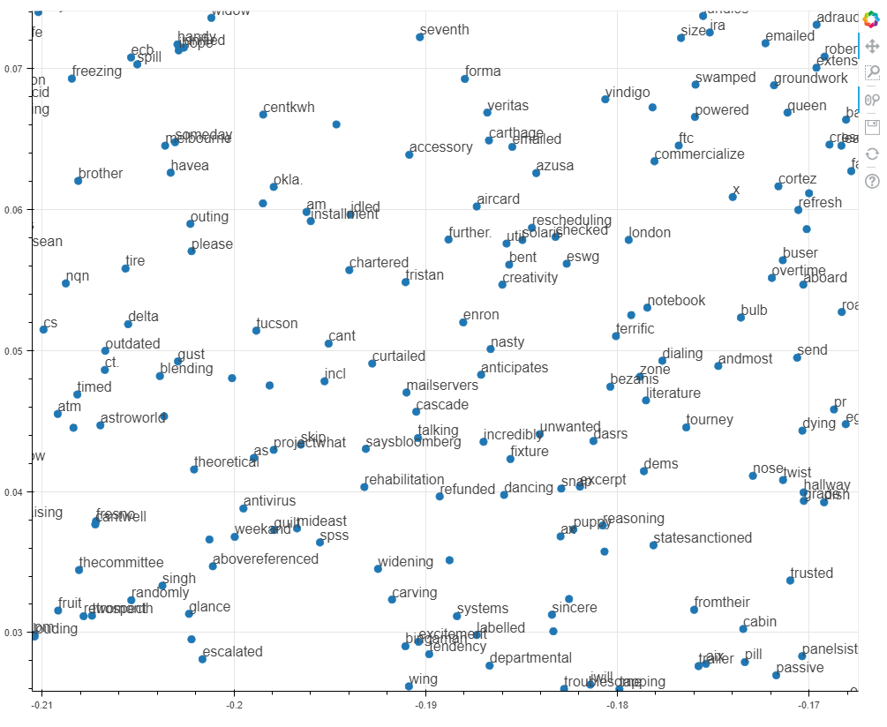
Vector Space Embedding
What it does:
Each word is represented in a hyperspace
PCA was used to compress into two-dimensional plot
Proximity can be used to determine semantic similarities
Obstacles:
Difficulties due to plot density and similarity in words (center vs. periphery)
Notes:
Di-Heng/Pablo
the meaning of a word can be “understood” by the words around it – when working with emails, this can be extended to relationships that detail events, sentiment and connections between people
It was difficult to decipher meaningful information, due to the density of the plot, and questions about the accuracy of PCA ➔ we preferred generating synonyms
Questions:
what do x,y access represent?
Did we use skipgrams of CBOW?
https://www.tensorflow.org/tutorials/representation/word2vec

Slide 8
findSynonyms - Emotions
“angry”
Word | Similarity
ill | 0.858687
ditch | 0.840186
olkjer | 0.826364
rhetoric | 0.801499
centipede | 0.793654
1990 | 0.792625
assemblywoman | 0.791674
appropriation | 0.791199
opponent | 0.790044
appointee | 0.788946
“happy”
Word | Similarity
7/26 | 0.806380
tomorrow | 0.802098
thanksgiving | 0.734290
tonight | 0.719697
sometime | 0.687850
aggie | 0.683622
fun | 0.674624
dinner | 0.674556
town | 0.674074
holiday | 0.674047
“scared”
Word | Similarity
million | 0.817563
giveaway | 0.810973
medanos | 0.810934
suffering | 0.804798
bearish | 0.797009
anger | 0.796818
atcs | 0.793925
truth | 0.789958
prolonged | 0.789803
tide | 0.787754
Notes:
Di-Heng
ATCS -
Air Traffic Control Section
Audit Tracking and Control System

Slide 9
findSynonyms – Key Words
“bankruptcy”
Word | Similarity
declared | 0.706292
retirement_plan | 0.652146
devastated | 0.647038
financially | 0.636717
wiped | 0.630777
bankruptcy_fund | 0.583629
severance | 0.575613
reach | 0.570305
compromised | 0.538574
selling | 0.535607
“subpoena”
Word | Similarity
criminal | 0.752743
protective | 0.722764
enforcement | 0.713606
investigation | 0.711194
citation | 0.709515
subpoenaed | 0.705847
wyden | 0.699541
angelides | 0.693089
drivon | 0.692449
issuance | 0.692085
“criminal”
Word | Similarity
investigation | 0.797935
lockyer | 0.780378
enforcement | 0.779321
subpoena | 0.752743
undermine | 0.741554
civil | 0.736647
urged | 0.731159
seeking | 0.726828
sought | 0.726743
hebert | 0.724035

Slide 10
findSynonyms - Names
“fastow”
Word | Similarity
chief_financial_officer | 0.877141
resigned | 0.817304
ljm | 0.794942
cfo | 0.794517
partnership | 0.791794
ljm2 | 0.778291
resignation | 0.767559
co-investment | 0.762129
ousted | 0.753967
chief_executive | 0.753697
“lay”
Word | Similarity
mr. | 0.785885
ken | 0.783046
writing | 0.724288
skilling | 0.713924
enron_chairman | 0.713258
urge | 0.648241
resignation | 0.642234
fastow | 0.627561
chief_executive | 0.627127
resigned | 0.604895
“scotto”
Word | Similarity
dte | 0.924580
observer | 0.909978
high-priced | 0.888406
lessen | 0.887437
conserve | 0.885230
disaster | 0.884355
attracted | 0.880962
mukherji | 0.879943
unusually | 0.877142
devastating | 0.876305

Slide 11
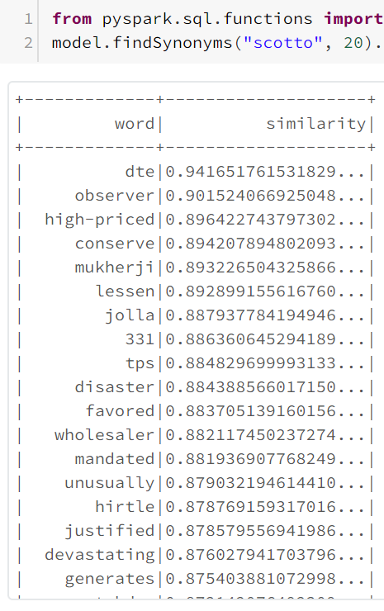
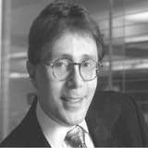
Wait… Scotto?
“Daniel Scotto was an American financial analyst during the period where Enron was cooking the books. In August 2001, he was an analyst with BNP Paribas, and Scotto made the drastic move to downgrade Enron securities from "Buy" to "Neutral". While this may not immediately seem to be a drastic decision, Scotto claims he was fired for this move. He took this action four months prior to the Enron accounting scandal that led to the company's bankruptcy, (and certain individuals earning a jail sentence).”
Notes:
Walker

Slide 12
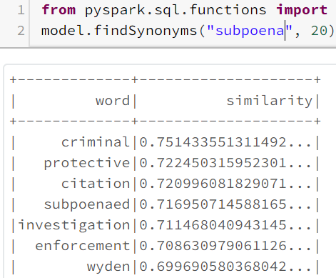
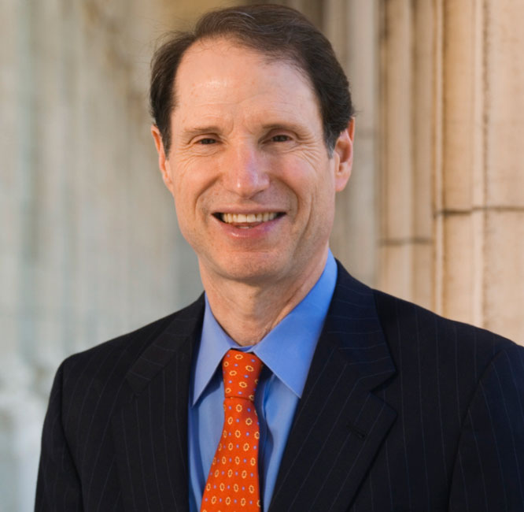
Who is Wyden?
Senior United States Senator for Oregon since 1996
Wyden charged Enron in In January 2002 with resorting "to a variety of legal, regulatory and accounting contortions to keep investors and the public in the dark" and asked for Congress to start an investigation into the issue.
Notes:
Walker

Slide 13
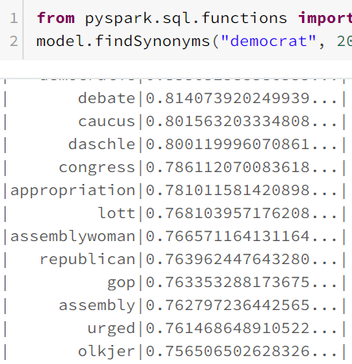
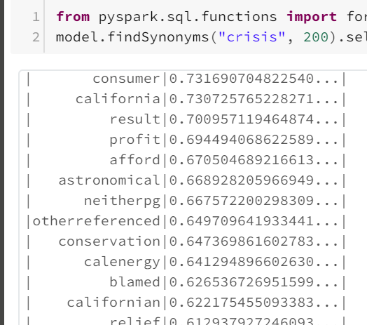
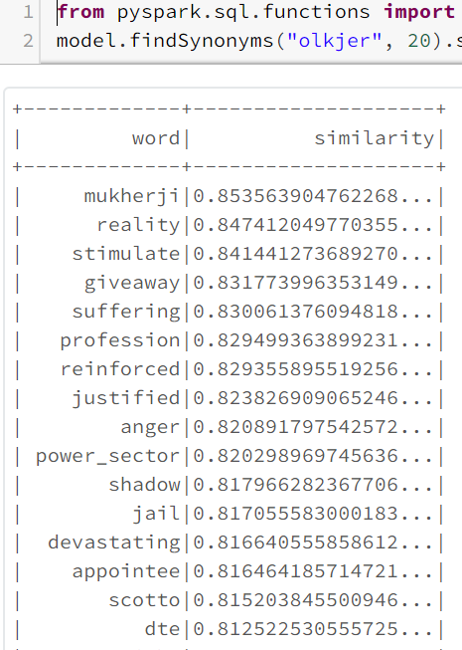
Olkjer and Why California is Important
Notes:
Walker

Slide 14
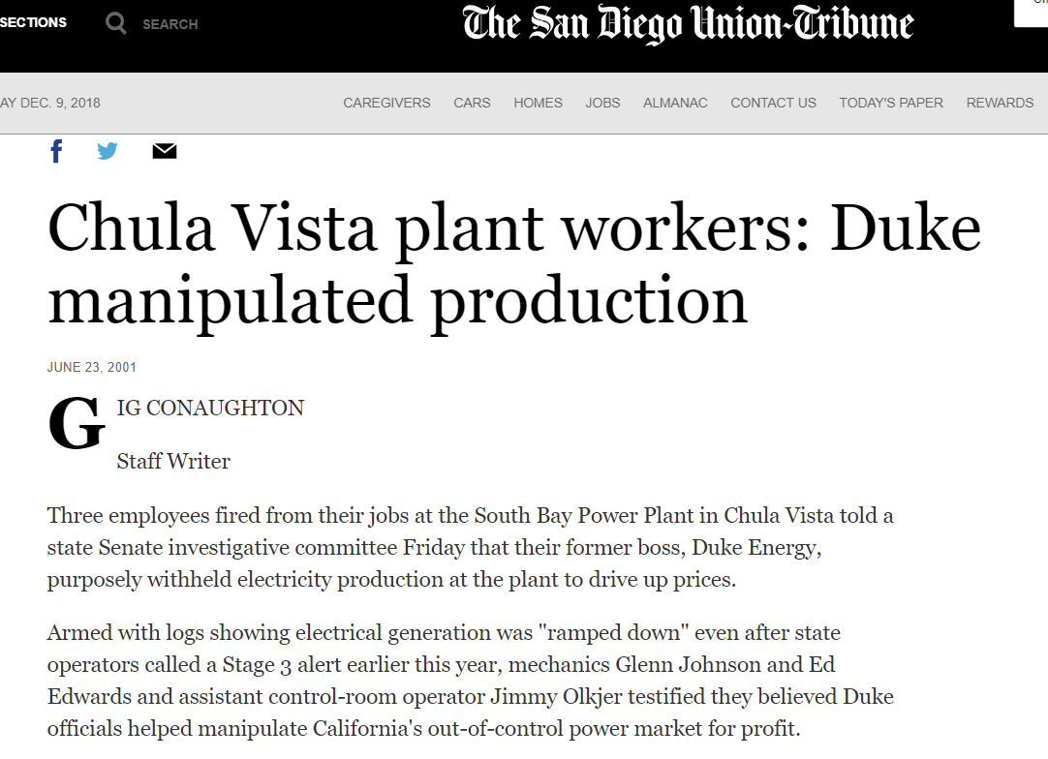
“The credibility of these former SDG&E employees was very weak in the hearing and their allegations are absurd.....”
Mid: 32036
Sender: karen.denne@enron.com
Timestamp: 2001-10-26, 13:51:19
Notes:
Walker

Slide 15
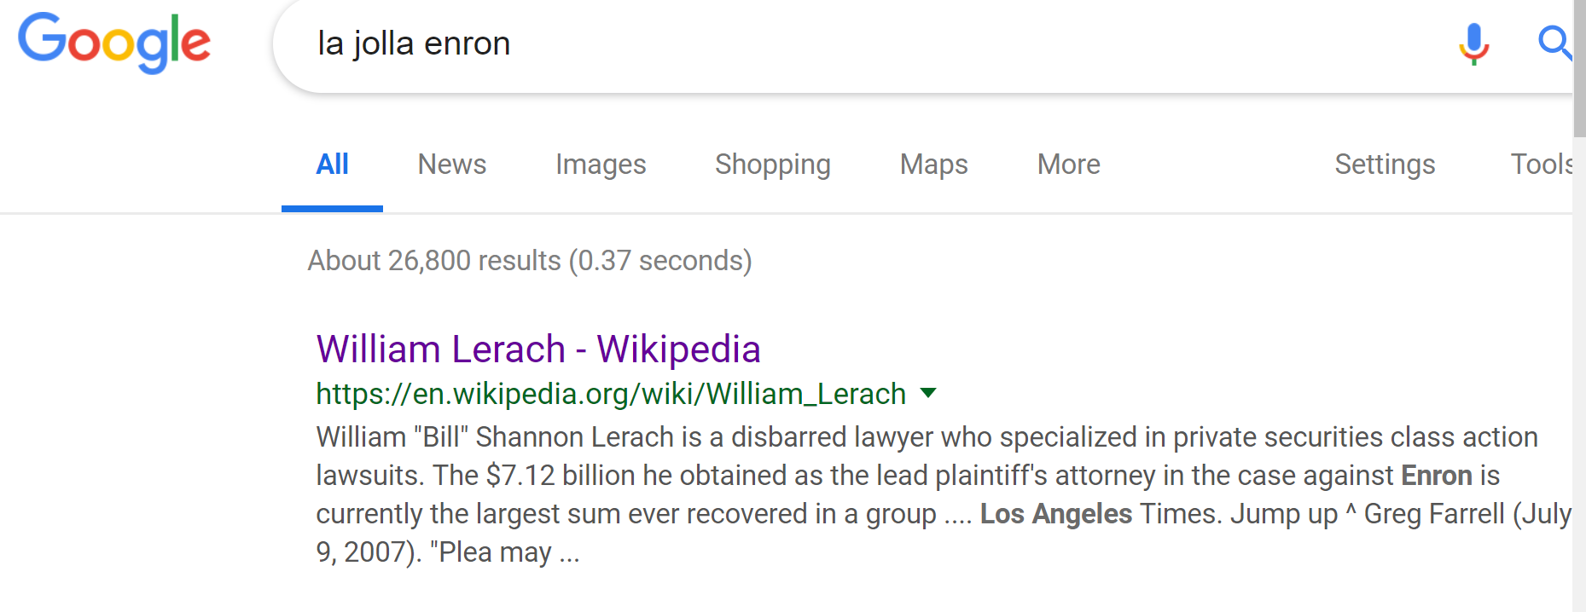
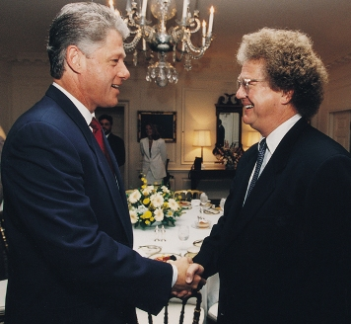
Where is this going… 7.12 billion dollars?
Notes:
Walker

Slide 16
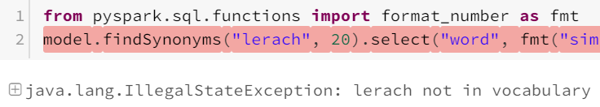
But surely, we could have just consulted the model?
Notes:
Walker

Slide 17

Loose ends: Mukherji
I can find nothing on this… name? Place? Pseudonym? Has anyone seen this term before?
Notes:
Walker

Slide 18



Sentiment analysis
Notes:
Shelina & Tian

Slide 19
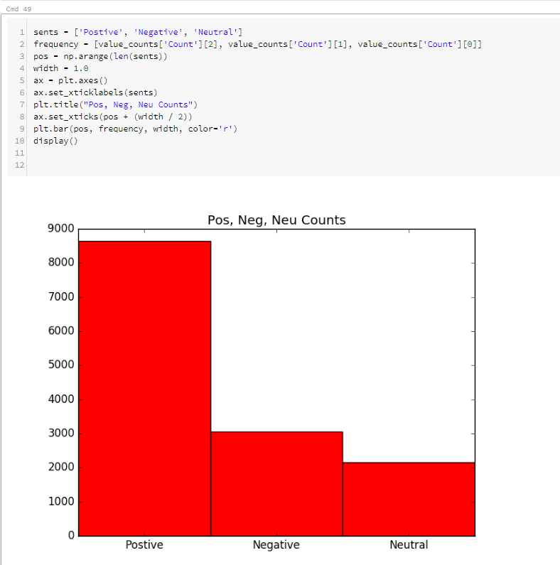
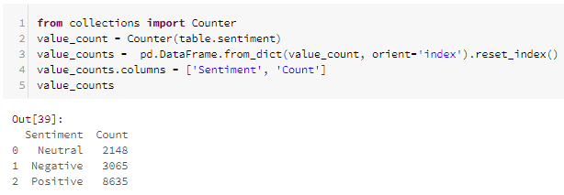
Polarity
Sentiment count for all emails in the corpus.

Slide 20
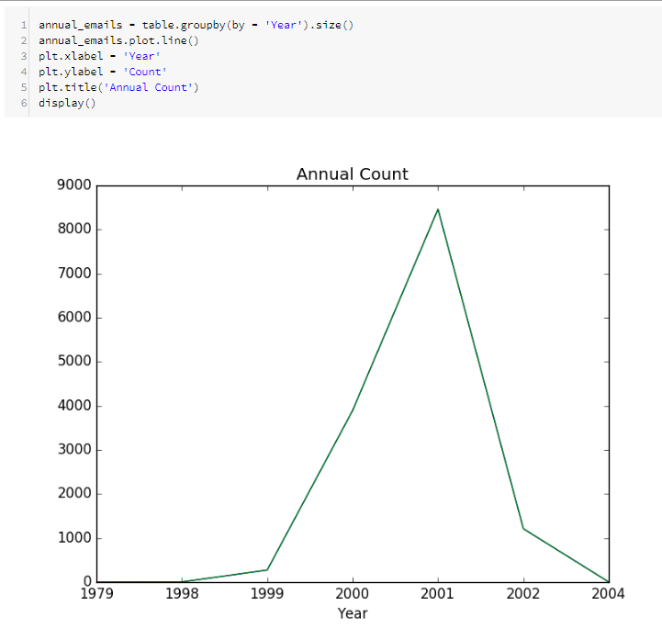
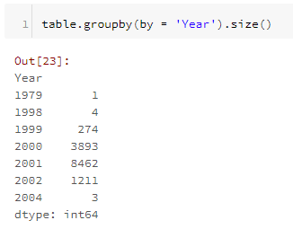
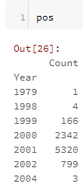
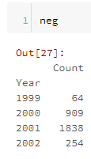
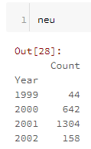
Email Distribution by Sentiment
Annual Email Count
Most emails were sent in 2001, more than double the previous year.
Annual Pos/Neg/Neu Counts

Slide 21
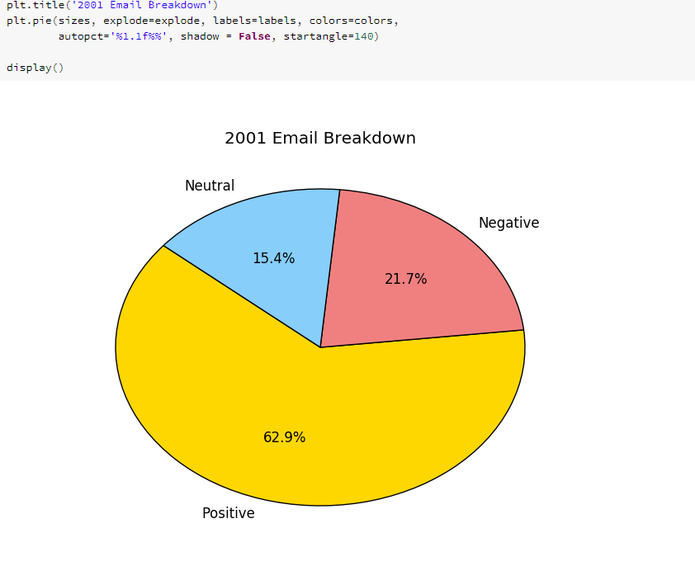
2001

Slide 22
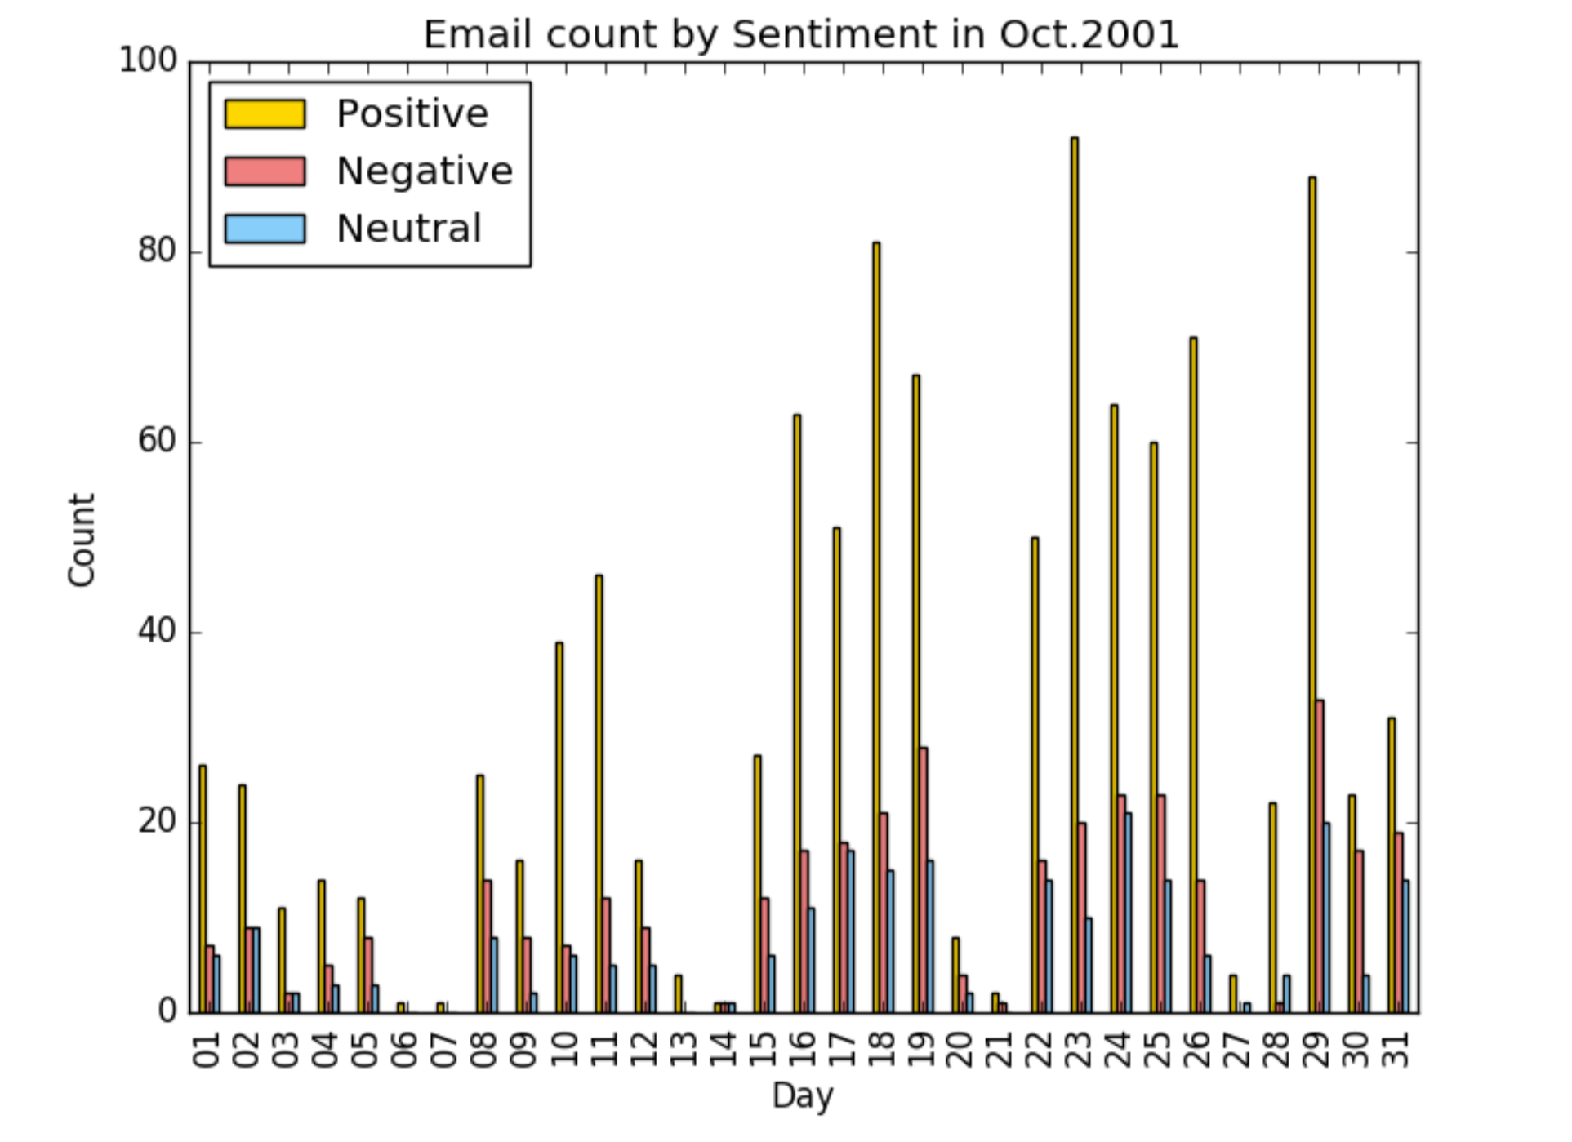
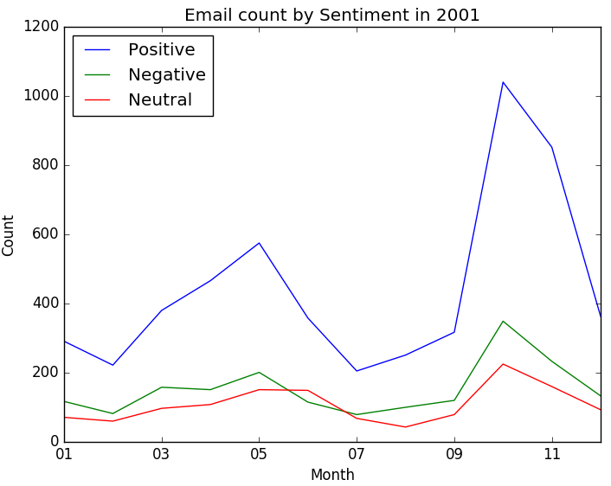
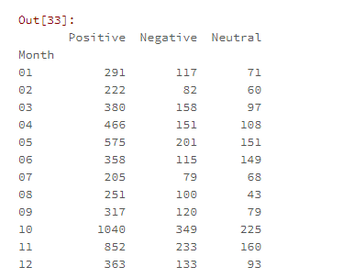
Monthly Sentiment in 2001

Slide 23

Implications of Research
The Power of Semantic Relationship
Knowledge Graphs
Notes:
Pablo & Walker

Slide 24
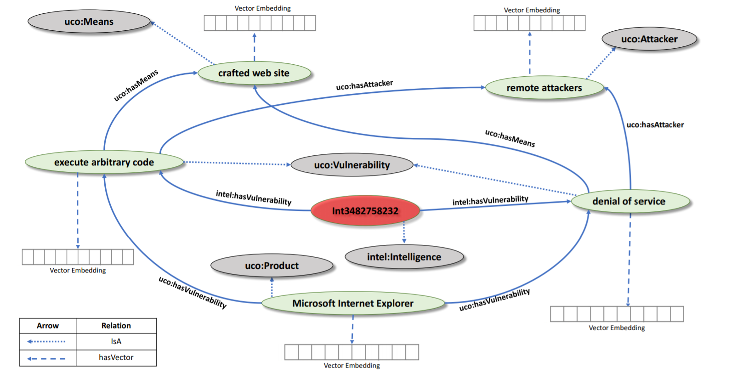
“Thinking, Fast and Slow: Combining Vector Spaces and Knowledge Graphs”

Slide 25

Questions?

